Slide 2
Modified Hodges
AGLRstep

Slide 3
AGLRstep_Laplace
Fuzzy Entropy

Slide 7
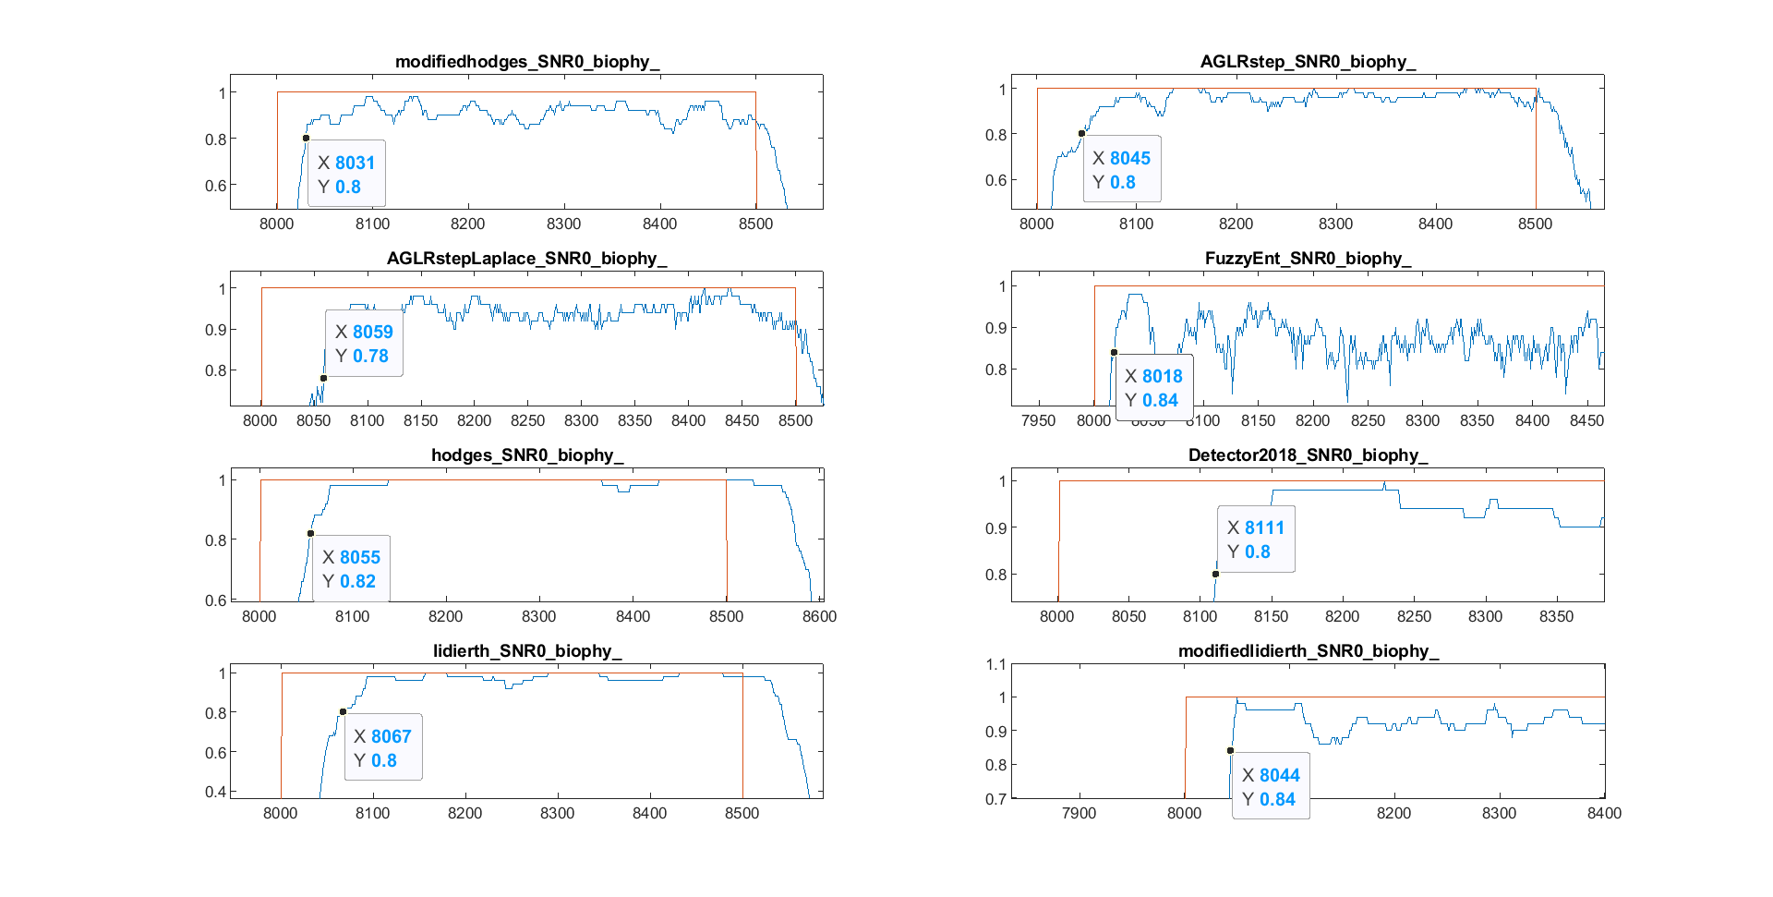

Slide 8
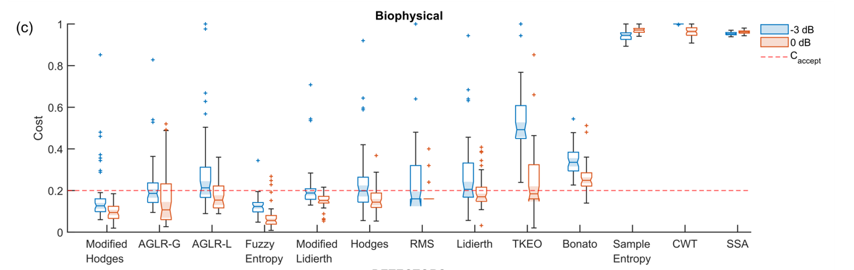

Slide 9
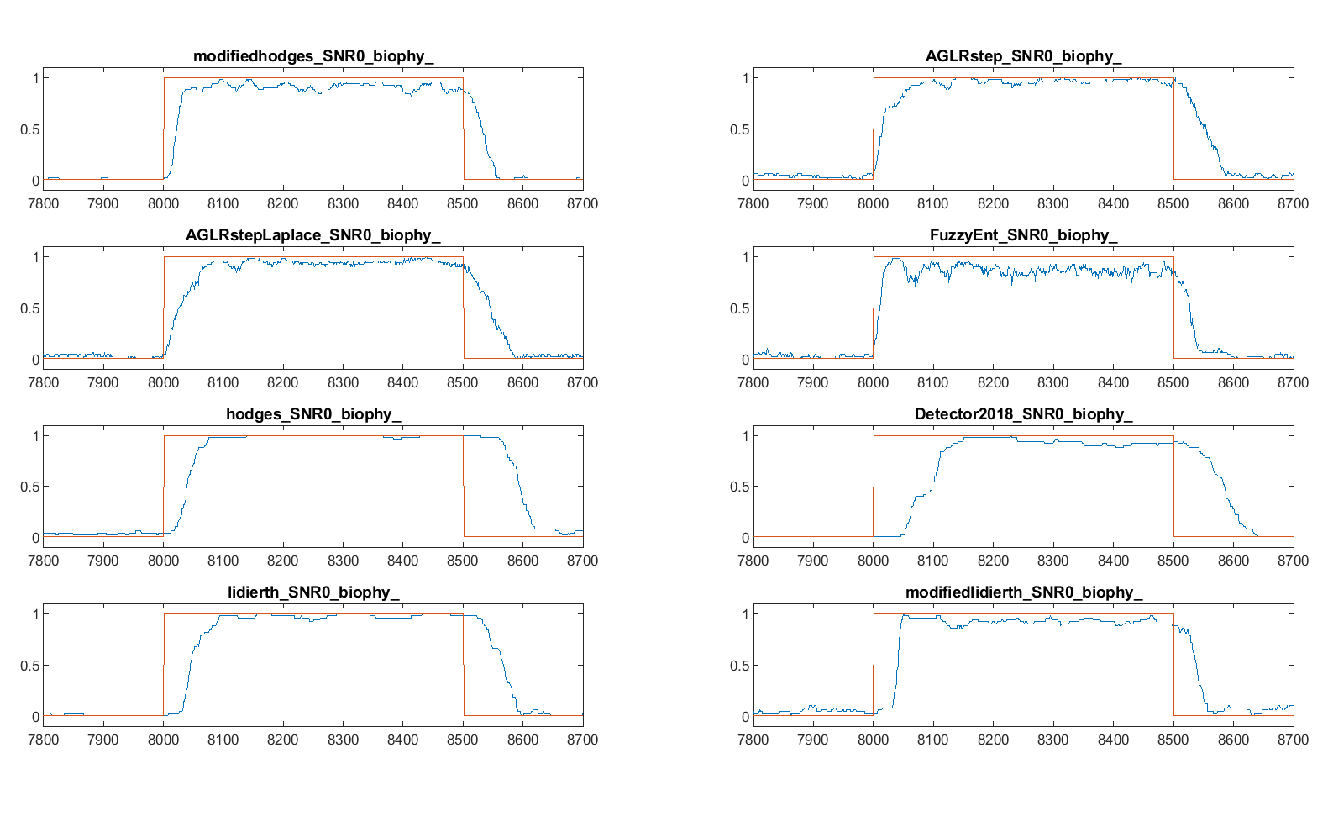

Slide 10
Asymmetry in latency on and Latency off

Slide 15
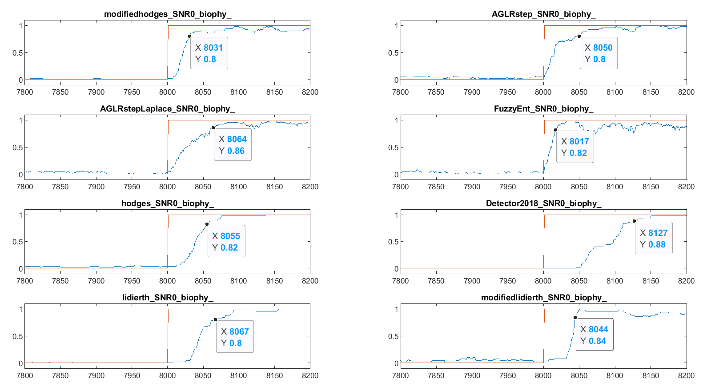
500 ms pulse duration data the

Slide 16
Ensemble averages of the binary output For the previous analysis

Slide 17
